Slide 1
Fall 2018
Student satisfaction Survey
Presented by:
Office of Research, Planning, and Institutional Effectiveness

Slide 2
Overview
Survey was sent to students enrolled in one or more classes at Golden West College during the Fall 2018 semester.
Purpose was to gather feedback from students regarding their experiences at Golden West College.
Survey questions were grouped in the following categories:
  Students’ profiles
  Overall student experience
  Experience with student support services and food services
  Evening student experience and hanging out on campus
Feedback was received from 186 students who completed the survey.

Slide 3
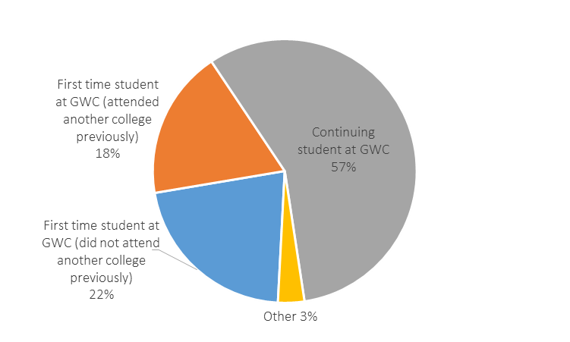
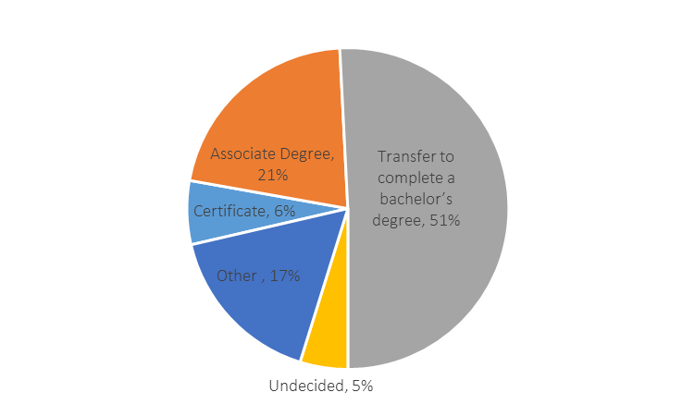
Respondents’ Profile
Respondents were asked to identify if they were first time students or continuing students
Educational Objective:

Slide 4
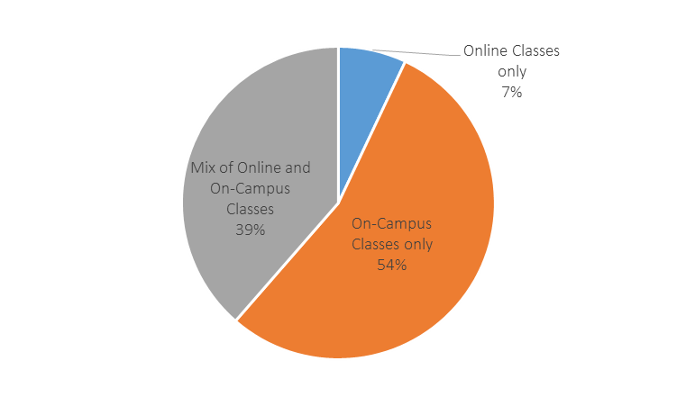
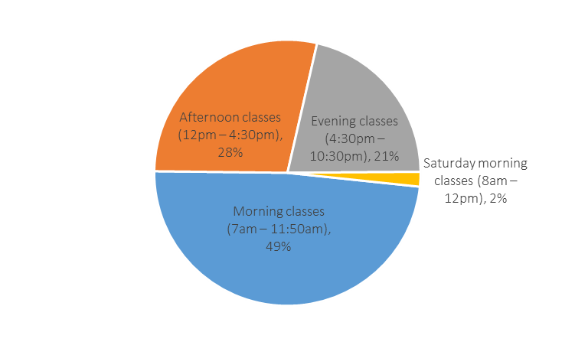
Respondents’ Profile
Times during the day respondents can
take most of their classes
Modality of Instruction:

Slide 5
Overall Student Experience
In general 94% of respondents shared that they feel safe on campus at GWC. Students also shared various aspects that make them feel welcomed at GWC:
“Majority of faculty and staff are very helpful and nice.”
“The campus environment makes me feel welcomed.”
“Staff in specific programs that I am a part of make me feel welcomed.”
“The Stand and the Rack are excellent resources that tells me GWC cares about us students and our well-being.”
“The open park-like feeling of GWC makes me feel welcomed.”

Slide 6
Overall Student Experience
Survey respondents were informed that the Student Services Center houses services such as Counseling, Financial Aid Office, Enrollment Center, Transfer Center, etc., and if they were able to access these services during business hours of 8:00 – 6:00pm (N=161)
  88.2% of respondents said “YES”
  11.8% of respondents said “NO”
Students who answered “NO” were asked to identify reasons for not being able to access the Student Services Center:
  “For working students these hours are not helpful, as classes usually starting by 4:30 pm and go past 6:00 pm.” And “I have to take time off of work in order to go in which is typically required of all the listed services.” (13 students shared similar responses)
  “I feel like every time I go in to the Student Services Center, I am always getting the run around and no one is in common communication with each other making it appear very unorganized.” (2 students shared this feeling)
  “I live to far from campus to make it there on time before classes due to family obligations.” (2 students)

Slide 7
Overall Student Experience
Students were asked the likelihood that they would participate in student activities if they were available during the following times (N=157):
Afternoons (12pm – 4pm)
  54.5% said YES
  45.5% said NO
Evenings (after 4:30pm)
  43.3% said YES
  56.7% said NO
Weekends
  32.7% said YES
  67.3% said NO

Slide 8
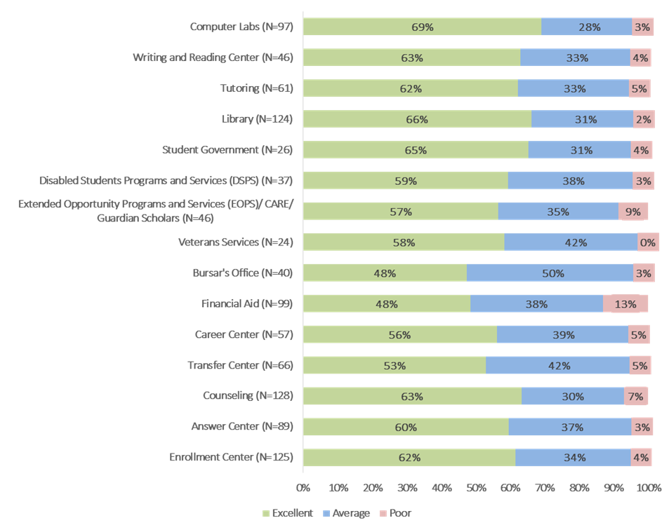
Experiences with Students Support Services
Students were asked to rate their level of satisfaction with the services they have utilized:

Slide 9
Experiences with Students Support Services
If students rated any of the above services as “POOR”, they were asked to share what GWC can do to improve these services. (N= 23)
General Comments:
  “Some workers do not know what they're doing and they keep misguiding due to improper handling of questions and documents.”
  “Had to follow up multiple times asking for a resolution & was given incorrect information by each area multiple times.”
  “Better employee attitudes. Majority are rude and seem like they do not want to help and are not pleasant.”

Slide 10
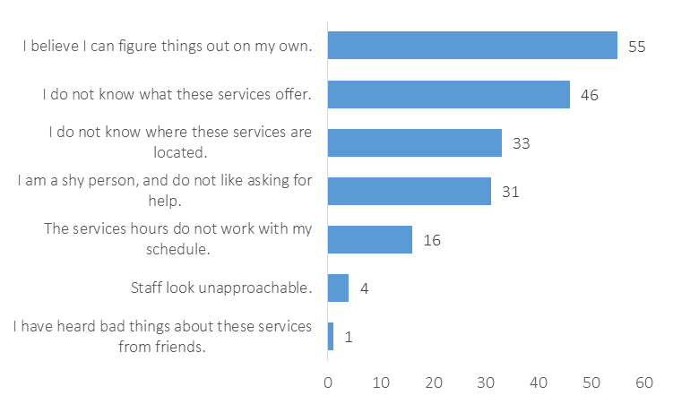
Experiences with Students Support Services
If students answered “I have not used this service” to any of the previously listed services, they were asked to identify the reasons they had not. Students were allowed to select as many reasons as they wanted to.

Slide 11
Evening Students’ Experiences
In general, 57.9% of respondents rate the overall quality of services offered to evening students at GWC as good or excellent. If students take most of their classes in the evening, they were asked to identify some of the reasons they choose to take classes at that time (N=154):
24.7% of respondents identified working during the day and can only attend classes in the evening.
22.7% of respondents identified that the classes they wanted were not available during the morning or afternoon.
11.7% of respondents identified having a preference for taking classes in the evening.
9.7% of respondents identified having family responsibilities during the day and can only attend classes in the evenings.
7.1% of respondents listed reasons such as choosing to sleep in finding themselves having to enroll in evening classes simply because of scheduling conflicts.
44.2% of respondents shared that this was not applicable to them.

Slide 12
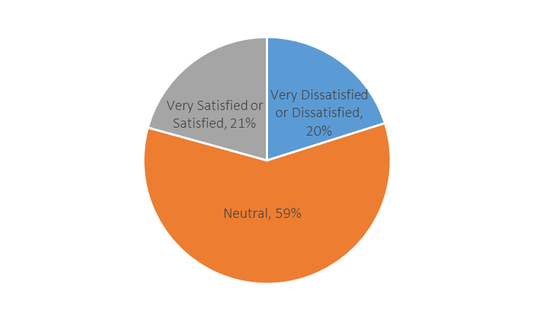
Evening Students’ Experiences- Food
Survey respondents were asked to rate their level of satisfaction with the food services on campus for evening students:

Slide 13
Evening Students’ Experiences
Students were asked to rate their level of agreement with the following statements using a Likert scale of strongly agree to strongly disagree (N=170).

Slide 14
Evening Students’ Experiences
After rating their level of agreement with the above statements, students were given the opportunity to make any comments related to the statements that they would like to make:
“I don’t feel like there is enough lighting or enough people on campus in the evening for me to feel safe.” (9 students shared a similar response)
  “There is a need to have security more out in the parking lots, making sure that we are making it safely to our cars late at night.”
“The library and other study spaces are not open late enough for us evening students to use them.” (3 students shared similar comments)
“Office hours are not very good with students like me that work during the day.” (2 students)

Slide 15
Students Hanging Out
In general, about 53% said that they do hang out on campus during their free time or between classes. When asked where they hang out during their free time or between classes students shared the following:
Library (38 respondents)
Cafeteria/ Student Center (26 respondents)
Quad/ Hammocks (19 respondents)
Benches throughout campus (13 respondents)
Native Garden (5 respondents)
STEM Center (4 respondents)
Veterans Resources Center (3 respondents)

Slide 16
Students Hanging Out
For the students who said that they do not hang out on campus during their free time or between classes, they were asked to select from a list the reason(s) they did not hang out more on campus. Students had the option to select multiple answers.

Slide 17
Students Hanging Out
Students were then asked to identify things that GWC could do to make other students want to hang out on campus more during their free time or between classes. The following are some of the students’ responses:
More lounge and study spaces throughout campus (33 respondents)
More events and activities during the day (31 respondents)
Better and cheaper food options in the cafeteria (20 respondents)
Free food, snacks and testing supplies throughout the semester (16 respondents)
More hammocks throughout campus (15 respondents)
Need for stronger Wi-Fi throughout the campus (13 respondents)

Slide 18
Open Comments
Lastly, students were given the opportunity to share any comments they wanted to share on how we can improve their student experience at Golden West College:
Positive comments:
  No. I like the campus and staff.
  I am super satisfied.
  Continue to always smile and greet students (:
  No, Golden West College is the best there is.
Suggestions for improvement comments:
  Extend office hours for those who have classes all day.
  Extend library hours especially during finals week.
  Add more campus activities and more hammocks.

